Slide 1
Cafeteria Line Manager Simulation
Queue Management Using Efficient Structures
COMFCI25/ Askerova Diana / 250142028
Option A — Cafeteria Line Manager (Queue with ArrayDeque

Slide 2
Problem Statement
In a busy cafeteria, people arrive at different times and form a line to be served. Some customers may have VIP priority and should be placed at the front of the queue. The goal of this project is to simulate a cafeteria queue system that: • Manages normal and VIP arrivals • Serves customers in the correct order • Tracks waiting time statistics • Simulates time using a logical clock The system must handle multiple commands such as: ARRIVE, VIP_ARRIVE, SERVE, LEAVE, PEEK, SIZE, PRINT, TICK, STATS.

Slide 3
Chosen Data Structures Two main data structures were used to implement the system.
ArrayDeque Used to represent the queue of customers. Advantages: • Fast insertion at the front or back • Efficient removal from the front • Ideal for FIFO queue behavior Operations used: • addLast() — normal arrival • addFirst() — VIP arrival • removeFirst() — serve next person • peekFirst() — check next person HashMap<String, Integer> Used to store arrival time of each person. Key: customer name Value: logical arrival time This allows the program to quickly calculate waiting time when the person is served.

Slide 4
Complexity Summary
Most operations are constant time, which makes the system efficient even with many customers.
operation | method | complexity
Normal arrival | addLast () | O(1)
VIP arrival | addFirst () | O(1)
Serve next person | removeFirst() | O(1)
Peek next | peekFirst() | O(1)
Remove person by name | removeFirstOccurrence() | O(n)
Lookup arrival time | HashMap get() | O(1) average
Store arrival time | HashMap put() | O(1) average

Slide 5
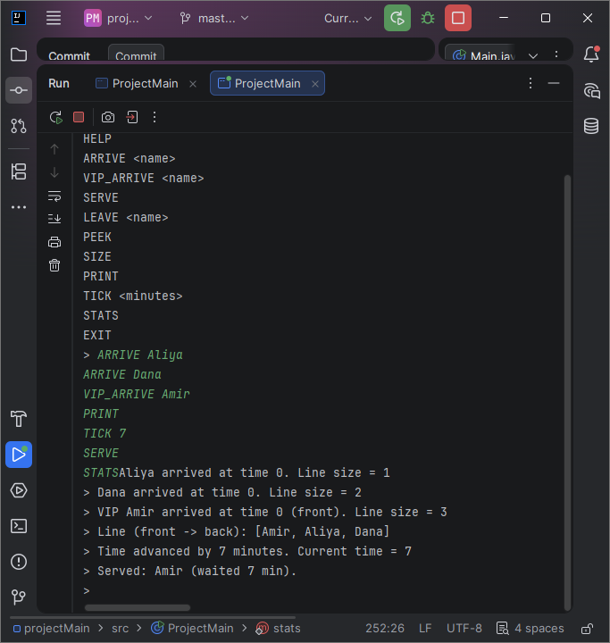
Demo (Console Example) Example program interaction:
This demonstrates: • queue behavior • VIP priority • time tracking • statistics calculation

Slide 6
Key Takeaways
Important lessons from this project: • Choosing the right data structure significantly improves performance. • ArrayDeque is ideal for queue operations. • HashMap enables fast lookup of arrival times. • Time complexity analysis helps predict scalability. This simulation shows how real-world systems like service queues can be modeled using efficient
data structures.

Slide 7
Conclusion
The Cafeteria Line Manager successfully demonstrates: • queue management • efficient data structures • time complexity concepts • basic performance analysis The program hcould include: • estimating waiting time • tracking maximum queue lengthandles multiple commands, tracks waiting time statistics, and simulates a real-world queue system. Future improvements • adding graphical visualization.

